Slide 1
Stability of the Scientific Software Stack: An Astronomical Perspective
Tuan Do
(UCLA)
2018-10-23 Second URSSI Workshop, Chicago

Slide 2
Goal: Study the physics and astrophysics of the supermassive black hole at the center of the Milky Way

Slide 3
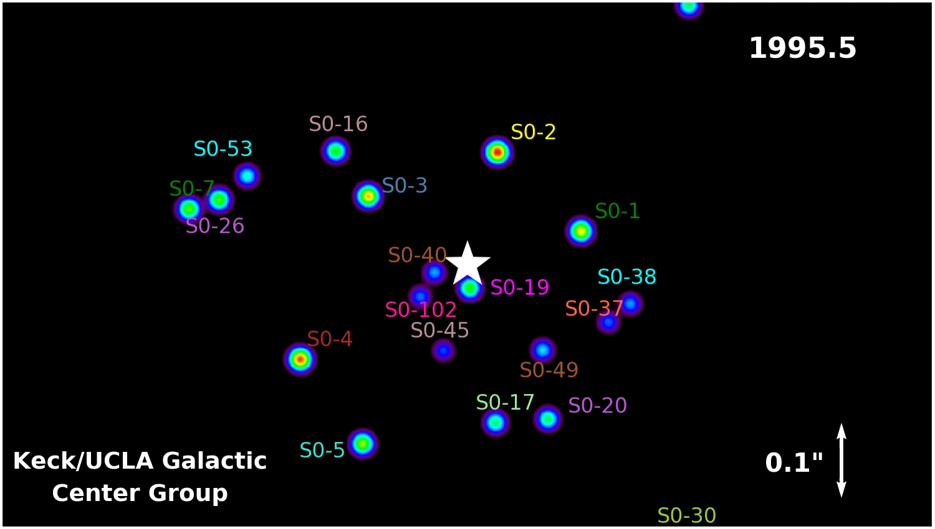

Slide 4
Over 23 years, the amount of code and dependencies have grown – how do we maintain and build software in a robust way?
How do we reproduce code? What time scale should we be able to reproduce code?

Slide 5
Project specific software
Galactic Center Group basic software libraries
General astronomical library (astropy, astroquery, etc..)
General scientific libraries (numpy, scipy, pandas)
Python (v2.7, v3.X)
Operating system (OS X)

